Slide 1
Basic Spring 5.0
Lesson 2:Introduction to Spring Framework, IoC
Notes:
Add instructor notes here.

Slide 2
Lesson Objectives
Introduction to Spring Framework
Learn about the Spring Framework, its benefits
and architecture
Learn about the IoC (Inversion of control) and
how it allows wiring beans
Learns the types of bean factories and life-cycle
of beans in these factories
Understand how to apply Annotations to Spring
applications
Injecting dependencies through setter and
constructor injections
Wiring Beans
Bean containers
Life cycle of Beans in the factory container
BeanPostProcessors and BeanFactoryPostProcessors
Annotation-based configuration
Notes:
Explain the lesson coverage

Slide 3
2.1 What is Spring Framework, Benefits of Spring
December 1996 – JavaBeans makes its appearance.
Intended as a general-purpose means of defining reusable
application components
Used more as a model for building user interface widgets
Sophisticated applications often require services not directly
provided by the JavaBeans specification
March 1998 – EJB was published.
But EJBs are complicated in a different way, that is, they
mandate deployment descriptors and plumbing code
Notes:
It all started with a bean. In 1996, the Java programming language was still a young, exciting, up-coming platform. Many developers flocked to the language because they had seen how to create rich and dynamic web applications using applets. But they soon learned that there is more to this strange new language than juggling animated cartoon characters. Unlike any language before it, Java made it possible to write complex applications made up of discrete parts. They came for the applets, but stayed for the components.
It was in December of that year that Sun Microsystems published the Java-Beans 1.00-A specification. JavaBeans defined a software component model for Java. This specification defined a set of coding policies that enabled simple Java objects to be reusable and easily composed into more complex applications. Although JavaBeans were intended as a general-purpose means of defining reusable application components, they have been primarily used as a model for building user interface widgets. They seemed too simple to be capable of any “real” work; enterprise developers wanted more.
Sophisticated applications often require services that are not directly provided by the JavaBeans specification such as transaction support, security, and distributed computing. Therefore in March 1998, Sun published the 1.0 version of the Enterprise JavaBeans (EJB) specification. This specification extended the notion of Java components to the server side, providing the much-needed enterprise services, but failed to continue the simplicity of the original JavaBeans specification. In fact, except in name, EJB bears very little resemblance to the original Javabeans specification.

Slide 4
2.1 What is Spring Framework -Benefits of Spring
Many successful applications were built based on EJB
But EJB never really achieved its intended purpose, which is to
simplify enterprise application development
Java development comes full circle
New programming techniques like including aspect-oriented
programming (AOP) and inversion of control (IoC) are giving
JavaBeans much of the power of EJB
Notes:
Despite the fact that many successful applications have been built based on EJB, it never really achieved its intended purpose: to simplify enterprise application development. It is true that EJB’s declarative programming model simplifies many infrastructural aspects of development, such as transactions and security. But EJBs are complicated in a different way by mandating deployment descriptors and plumbing code (home and remote/local interfaces). As a result, its popularity has started to wane in recent years, leaving many developers looking for an easier way.
Now Java development is coming full circle. New programming techniques, including aspect-oriented programming (AOP) and inversion of control (IoC), are giving JavaBeans much of the power of EJB. These techniques furnish JavaBeans with a declarative programming model reminiscent of EJB, but without all of EJB’s complexity. No longer must you resort to writing an unwieldy EJB component when a simple JavaBean will suffice.
And that’s where Spring steps into the picture.
Quick history :
Spring Framework project founded in Feb 2003
Release 1.0 in Mar 2004
Release 1.2 in May 2005
Release 2.0 in Oct 2006
Release 2.5 in Nov 2007
Release 3.0 in Dec 2009
Release 4.0 in Dec 2013
In all fairness, the latest EJB specification (EJB 3) has evolved to promote POJO-based programming model and is simpler than its predecessors.

Slide 5
2.1 What is Spring Framework -Benefits of Spring
Spring is an open source framework created by Rod Johnson,
Juergen Hoeller et all
Addresses the complexity of enterprise application development
Any java application can benefit from Spring in terms of
simplicity, testability and loose coupling
Notes:
Spring makes it easy to use POJO (Plain Old Java Objects) to achieve things that were previously only possible with EJBs. However, Spring’s usefulness isn’t restricted to server-side development. Any java application can benefit from Spring in terms of simplicity, testability and loose coupling.

Slide 6
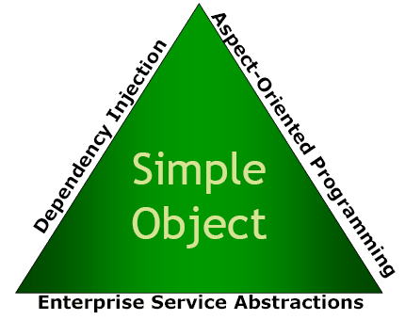
2.1 What is Spring Framework, Benefits of Spring
Spring is a lightweight inversion of
control and aspect-oriented container
framework
Lightweight: in terms of both size and
overhead
Inversion of control: promotes loose
coupling
Aspect-oriented: enables cohesive
development by separating application
business logic from system services
Container: contains and manages the
life cycle and configuration of
application objects
Framework: possible to configure and
compose complex applications from
simpler components
Notes:
Put simply, Spring is a lightweight inversion of control and aspect-oriented container framework. Breaking this description down makes it simpler:
Lightweight: Spring is Lightweight in terms of both size and overhead. The entire Spring framework can be distributed in a single jar file of 2.5 MB approximately. Processing overhead required by Spring is negligible. Moreover, Spring is non-intrusive; objects in a Spring-enabled application typically have no dependencies on Spring-specific classes.
Inversion of control: Spring promotes loose coupling through a technique known as inversion of control (IoC) or also known popularly as Dependency Injection (DI). When IoC is applied, objects are passively given their dependencies instead of creating or looking for dependent objects for themselves. IoC can be thought of as JNDI in reverse – instead of an object looking up dependencies from a container, the container gives the dependencies to the object at instantiation without waiting to be asked.
Aspect-oriented : Spring comes with rich support for aspect-oriented programming that enables cohesive development by separating application business logic from system services (such as auditing and transaction management). Application objects do what they are supposed to do – perform business logic – and nothing more. They are not responsible for other system concerns such as logging or transactional support.
Container: Spring is a container in the sense that it contains and manages the life cycle and configuration of application objects. You can configure how each of your beans should be created – either create one single instance of your bean or produce a new instance every time one is needed based on a configurable prototype – and how they should be associated with each other.
Framework: Spring makes it possible to configure and compose complex applications from simpler components. In Spring, application objects are composed declaratively, typically in an XML file. Spring also provides much infrastructure functionality (transaction management, persistence framework integration etc) leaving the development of application logic to user.
All these attributes of Spring enable you to write code that is cleaner, more manageable and easier to test.

Slide 7
2.1 What is Spring Framework, Benefits of Spring
Spring simplifies Java development
With Spring, complexity of application is proportional to the
complexity of the problem being solved
Essence of Spring is to provide enterprise services to POJO.
Spring employs four key strategies:
Lightweight and minimally invasive development with plain old
Java objects (POJOs)
Loose coupling through dependency injection and interface
orientation
Declarative programming through aspects and common
conventions
Boilerplate reduction through aspects and templates
Notes:
To put it simply, Spring makes developing enterprise applications easier. The complexity of your application is proportional to the complexity of the problem being solved.
Some key Spring values are:
It’s a non-invasive framework : Traditional frameworks force application code to be aware of the framework, implementing framework specific interfaces or extending framework-specific classes. Spring aims to minimize the dependence of application code on the framework.
Promotes pluggability : Spring encourages you to think of application objects as named services. Thus you can swap one service for another without affecting the rest of the application.
Aims to facilitate good programming practices, such as programming to interfaces: Using an IoC container like Spring reduces the complexity of coding to interfaces, rather than classes.
Spring applications are easy to test : Application objects will generally be POJOs and POJOs are easy to test; dependence on Spring APIs will normally be in the form of interfaces that are easy to stub or mock.
Does not reinvent the wheel : Spring does not introduce its own solution in areas such as O/R mapping where there are already good solutions. It also does not implement its own logging abstraction, connection pool, distributed transaction coordinator or other system services that are already well-served in other products or application servers. However Spring does make these existing solutions significantly easier to use.
Spring attacks Java complexity using the 4 strategies given. Almost everything Spring does can be traced back to one or more of these four strategies.

Slide 8
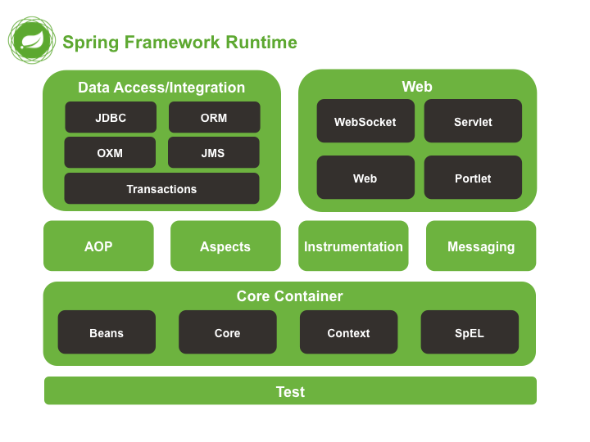
2.2 Spring 5.0 architecture
Notes:
The Spring Framework is composed of about 20 modules. These modules are grouped into Core Container, Data Access/Integration, Web, AOP (Aspect Oriented Programming),
Instrumentation, Messaging, and Test. When you download and unzip the Spring framework distribution, you’ll find many different JAR files in the dist directory for every modules. When taken as a whole, these modules give you everything you need to develop enterprise-ready applications. But this modularity also gives you the freedom to choose the modules that suit your application.
Core Container : The Core Container consists of the spring-core, spring-beans, spring-context, spring-context-support, and spring-expression (Spring Expression Language) modules.
The spring-core and spring-beans modules are the most fundamental part of the framework. It defines how beans are created, configured and managed. The BeanFactory (a sophisticated implementation of the factory pattern and a primary component of this module) applies the Inversion of Control (IOC) pattern to separate an application's configuration and dependency specification from the actual application code
The spring-context module builds on the solid base provided by the Core and Beans modules. The core modules bean factory makes Spring a container, but the context modules makes it a framework. The Context module inherits its features from spring-beans module and adds support for internationalization, event-propagation, resource-loading etc.
The spring-expression module provides a powerful expression language for querying and manipulating an object graph at runtime.
Spring could potentially be a one-stop-shop for all your enterprise applications. However, Spring is modular, allowing you to use parts of it, without having to bring in the rest. You can use the bean container, with Struts on top, or you could choose to just use the Hibernate integration or the JDBC abstraction layer.
The spring.jar artifact that contained almost the entire framework in pre Spring 3.0 is no longer provided. The framework modules have been revised and are now managed separately with one source-tree per module jar

Slide 9
2.2 Spring 5.0 architecture
Notes here
Notes:
Data Access/Integration : The Data Access/Integration layer consists of the spring--JDBC, spring--ORM, spring--OXM, spring--JMS and spring—tx modules.
The spring-jdbc module provides a JDBC-abstraction layer that removes the need to do tedious JDBC coding and parsing of database-vendor specific error codes.
The spring-orm module provides integration layers for popular object-relational mapping APIs, including JPA, JDO, Hibernate, and iBatis. Using the ORM package you can use all of these O/R-mapping frameworks in combination with all of the other features Spring offers.
The spring-oxm module provides an abstraction layer that supports Object/XML mapping implementations for JAXB, Castor, XMLBeans, XStream etc.
The spring-jms(Java Messaging Service) module contains features for producing and consuming messages.
The spring-tx(Transaction) module supports programmatic and declarative transaction management for classes that implement special interfaces and for all your POJOs (plain old Java objects).
Web : The Web layer consists of the spring-web, spring-webmvc, spring-websocket and spring-webmvc-portlet modules.
The spring-web module provides basic web-oriented integration features such as multipart file-upload functionality and the initialization of the IoC container using servlet listeners and a web-oriented application context.
The spring-webmvc module (also known as the Web-Servlet module) contains Spring's model-view-controller (MVC) implementation for web applications. Spring's MVC framework provides a clean separation between domain model code and web forms, and integrates with all the other features of the Spring Framework.
The spring-webmvc-portlet module (also known as the Web-Portlet module) provides the MVC implementation to be used in a portlet environment and mirrors the functionality of Web-Servlet module.
AOP and Instrumentation : AOP (Aspect Oriented Programming) enables behavior that would otherwise be scattered through different methods to be modularized in a single place.
The spring-aop module provides an AOP Alliance-compliant aspect-oriented programming implementation allowing you to define, for example, method interceptors and pointcut’s to cleanly decouple code that implements functionality that should be separated.
The separate spring-aspects module provides integration with AspectJ.
The spring-instrumentation module provides class instrumentation support and classloader implementations to be used in certain application servers.
Messaging: Spring Framework 4 includes a spring-messaging module with key abstractions from the Spring Integration project such as Message, MessageChannel, MessageHandler, and others to serve as a foundation for messaging-based applications. The module also includes a set of annotations for mapping messages to methods, similar to the Spring MVC annotation based programming model.
Test : The spring-test module supports the testing of Spring components with JUnit or TestNG. It provides consistent loading of Spring ApplicationContexts and caching of those contexts. It also provides mock objects that you can use to test your code in isolation.
Only the core Spring Framework is covered in this course. The whole Spring portfolio includes several frameworks and libraries that build upon the core Spring Framework and upon each other. All together, the entire Spring portfolio brings the Spring programming model to almost every facet of Java development.
What lies beyond the core framework?
Spring web flow
Spring web services
Spring security
Spring integration
Spring batch
Spring social
Spring mobile
Spring dynamic modules
Spring ldap
Spring rich client
Spring.Net
Spring-flex
Spring roo

Slide 10



2.3 Dependency Injection
Any enterprise application has objects that depend on each other
Resolving the dependency is termed as ‘Injecting Dependency’
which facilitates loose coupling.
Choosing the low level implementation to be injected into the
reference of the interface in higher level layer, is termed as
‘Inversion Of Control’
Notes:
Dependency Injection
Any enterprise application has objects that depend on each other
Resolving the dependency is termed as ‘Injecting Dependency’ which facilitates loose coupling.
Choosing the low level implementation to be injected into the reference of the interface in higher level layer, is termed as ‘Inversion Of Control’
Thus the choice of low level dependency has control on the quality of the service that will be provided, this is configurable/changeable making the framework highly flexible and modular
For an example, if a person need to have a cup of coffee then either he can prepare by himself using ingredients such as coffeebean, milk, sugar,.. Or he can raise request in vending machine, so that coffee will be prepared and automatically delivered to him.
Similarly, instead of creating object manually with the use of new operator, object creation will be taken care by container using DI.

Slide 11
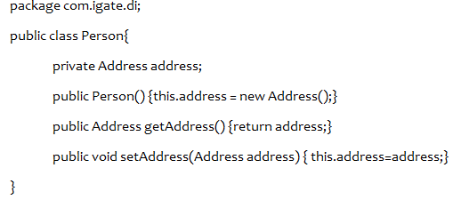
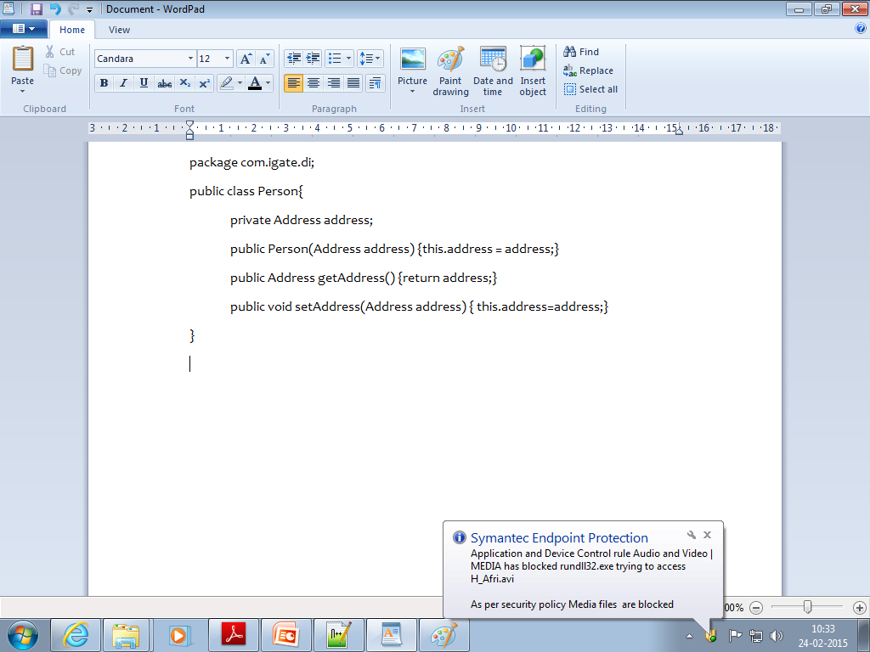

2.3 Dependency Injection-Sample Code
Tight coupling
Rigid design
Loose coupling
Flexible Design
Provisioning DI
Design to Interface
Enabling Loose Coupling, Flexibility
Notes:
Additional notes for instructor
In DI or IOC process objects define their dependencies, only through constructor arguments, arguments
to a factory method, or properties that are set on the object instance after it is constructed or returned
from a factory method. The container (the environment provided to the Spring Beans, for wiring) then injects those dependencies when it creates the spring bean, this process is an inverse of traditional approach, hence the name Inversion of Control (IoC), of the bean itself
controlling the instantiation or location of its dependencies by using direct construction of classes.

Slide 12
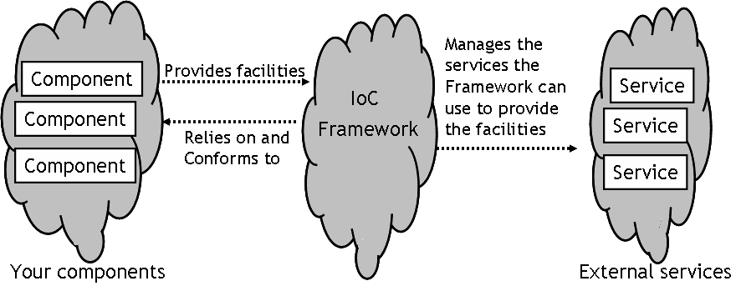
2.4 : Inversion of Control (IoC)- loC Concepts
Bar
Foo
services are injected
Notes:
Understanding inversion of control: Inversion of control is at the heart of the Spring framework. As seen earlier, any non-trivial application is made up of two or more classes that collaborate with each other to perform some business logic. Traditionally, each object is responsible for obtaining its own references to the objects it collaborates with (its dependencies). This can lead to a highly coupled and hard-to-test code.
Applying IoC, objects are given their dependencies at creation time by some external entity that coordinates each object in the system ie dependencies are injected into objects. So, IoC means an inversion of responsibility with regard to how an object obtains references to collaborating objects.
Dependency injection is kind of an Inversion of Control pattern. The term dependency injection describes the process of providing (or injecting) a component with the dependencies it needs, in an IoC fashion. Dependency Injection proposes separating the implementation of an object and the construction of objects that depend on them.
Dependency injection is a form of PUSH configuration; the container pushes dependencies into application objects at runtime. This is opposite to the traditional PULL configuration in which the app object pulls dependencies from its environment.
In the figure, we have application objects offering external services. The application components depend on these external services. The job of coordinating the implementation and construction is left to the assembler code, which In this case would be the spring IoC framework.

Slide 13
2.4 IoC, Beans and BeanFactories
Used to achieve loose coupling between several interacting
components in an application.
The IoC framework separates facilities that your components are
dependent upon and provides the “glue” for connecting the
components.
DI it is specific type of IoC
BeanFactory is the core of Spring’s DI container.
In Spring, the term “bean” is used to refer to any component
managed by the container.
Notes:
Loose coupling is one of the critical elements in object-oriented software development. It allows you to change the implementations of two related objects without affecting the other object. Strong coupling directly affects scalability of an application. Tightly coupled code is difficult to test, reuse and understand. On the other hand, completely uncoupled code doesn’t do anything. In order to do anything useful, classes need to know about each other somehow. Coupling is necessary but it must be managed very carefully. A common technique used to reduce coupling is to hide implementation details behind interfaces so that actual implementation class can be swapped out without impacting the client class.
That is what IoC is all about: the responsibility of coordinating collaboration between dependent objects is transferred away from the objects themselves. This is where lightweight framework containers like Spring come into play.
IoC introduces the concept of a framework of components that in turn has many similarites to a J2EE container. The IoC framework seperates facilities that your components are dependent upon and provides the “glue” for connecting the components.
With Inversion of Control (IoC), you can achieve loose coupling between several interacting components in an application.
The core of Spring’s DI container is the BeanFactory. A bean factory is responsible for managing components and their dependencies. We shall see bean factories in detail later in this session. In Spring, the term “bean” is used to refer to any component managed by the container. Typically, beans adhere to Javabeans specification

Slide 14
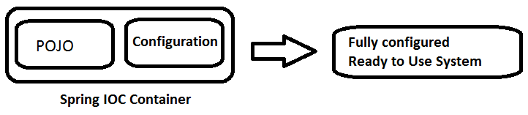
2.4 Spring Beans and Configuration Metadata
Spring Managed POJOs with business logic are
termed as Spring Beans, Spring IOC container
manages one or more beans
Spring meta-data configuration can be …
XML based
Java based : Annotations
Java based configurations are recommended
practice since inclusion of Spring JavaConfig
project
Spring Beans and Configuration Metadata is
combined and the Spring Framework’s IoC
container is created & initialized
Spring IoC container is decoupled from
configuration metadata format
Notes:
Additional notes for instructor

Slide 15
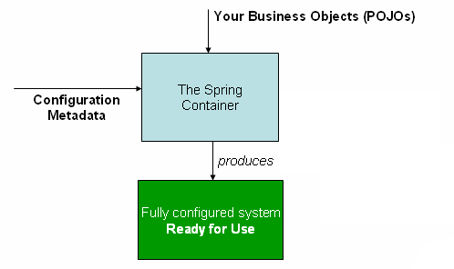
2.4 Spring IOC Container
The Spring IOC container instantiates, configures, and
assembles the beans by reading configuration metadata
It composes the application and interdependencies between
the objects
At this stage, the application is fully configured and ready to
use
The Spring IOC Container manages the entire lifecycle of the Spring Beans
Notes:
Additional notes for instructor
The Spring IOC container can manage any class you want it to manage; it is not limited to managing true JavaBeans
Spring container can also handle non-bean-style classes
Spring IoC container manages one or more beans
In the Spring IOC container, bean definitions are represented as BeanDefinition objects, with metadata:
A package-qualified class name
Bean behavioural configuration elements
References to other beans, collaborators or dependencies
Configuration settings to set in the newly created object, for example, the number of connections to use in a bean that manages a connection pool, or the size limit of the pool

Slide 16
2.4 Spring Jumpstart with HelloWorld
package training.spring;
public class HelloWorld {
public void sayHello(){
System.out.println("Hello Spring 3.0");
}
}
<?xml …..>
<beans ….>
<bean id="HWBean" class =
"training.spring.HelloWorld" />
</beans>
The Spring configuration file
public class HelloWorldClient {
public static void main(String[] args) {
XmlBeanFactory beanFactory = new XmlBeanFactory
(new ClassPathResource("HelloWorld.xml"));
HelloWorld bean = (HelloWorld) beanFactory.getBean("HWBean");
bean.sayHello();
}
}
Output:
Hello Spring 3.0
Notes:
Dependency injection is the most basic thing that Spring does. We shall be covering this in detail later in the session. For now, let us see how Spring works with an example.
Spring-enabled applications are like any Java application. They are made up of several classes, each performing a specific purpose within the application. Difference lies in how these classes are configured and introduced to each other. Typically a Spring application has an XML file that describes how to configure the classes, known as Spring configuration file.
Pls. refer to Appendix-A for a detailed explanation of converting a traditional Java application into a Spring-based application.
Look in slide above for a typical Hello World application using Spring Framework. Detailed explanation for this code is given in subsequent demos.
Instructor to explain this code and execute the demo

Slide 17
2.4 : Inversion of Control (IoC) -Inversion of Control Approaches
IoC pattern uses three different approaches to
achieve decoupling of control of services from
components:
Type 1: Setter Injection
Type 2: Constructor injection
Type 3: Interface injection
Notes:
The IoC pattern uses three different approaches to achieve decoupling of control of services from your components:
Type 1 : Interface injection: This is how most J2EE worked. Components are explicitly conformed to a set of interfaces with associated configuration metadata, in order to allow framework to manage them correctly.
Type 2 : Setter Injection: External metadata is used to configure how components can interact. Our first example used this approach, by using a Springconfig.xml file.
Type 3 : Constructor injection: Components are registered with the framework, including the parameters to be used when the components are constructed, and the framework provides instances of the component with all the specified facilities applied. Our last example used this approach.
There is a fourth approach called “Lookup-method injection”. This has been covered in detail in Appendix-B.

Slide 18
2.4 : Inversion of Control (IoC) -Injecting dependencies via setter methods
public interface CurrencyConverter {
public double dollarsToRupees(double dollars);
}
public class CurrencyConverterImpl implements CurrencyConverter {
private double exchangeRate;
public double getExchangeRate() { return exchangeRate; }
public void setExchangeRate(double exchangeRate) {
this.exchangeRate = exchangeRate; }
public double dollarsToRupees(double dollars) {
return dollars * exchangeRate;
}
}
POJO
Notes:
The example shows a service class whose purpose is to print the value of dollars converted to rupees. The listing above shows CurrencyConverter.java, an interface that defines the contract for the service class.
CurrencyConverterImpl.java implements the CurrencyConverter interface. Although it is not necessary to hide the implementation behind an interface, its highly recommended as a way to separate the implementation from its contract.
The CurrencyConverterImpl class has a single property exchangeRate. This property is simply a double variable that will hold the exchange rate passed by its setter method. We can also pass value through the constructor (We shall see this in the next example)

Slide 19
2.4 : Inversion of Control (IoC) -Injecting dependencies via setter methods
<?xml version="1.0" encoding="UTF-8"?>
<beans xmlns="http://www.springframework.org/schema/beans"
xmlns:xsi="http://www.w3.org/2001/XMLSchema-instance" xmlns:aop="http://www.springframework.org/schema/aop"
xsi:schemaLocation="http://www.springframework.org/schema/beans http://www.springframework.org/schema/beans/spring-beans-4.0.xsd">
<bean id="currencyConverter"
class="training.Spring.CurrencyConverterImpl">
<property name="exchangeRate" value="44.50" />
</bean>
</beans>
The configuration file (CurrencyConverter.xml)
Notes:
Question now is who will make a call to either the constructor or the setExchangeRate() method to set the exchangeRate property? The Spring configuration file in the above listing tells how to configure the CurrencyConverter service. This XML file declares an instance of a CurrencyConverterImpl in the Spring container and configures its exchangeRate property with a value of 44.50.
Notice the <beans> element at the root of the XML file. This is the root element of any Spring configuration file. The <bean> element is used to tell the Spring container about a class and how it should be configured. The id attribute is used to name the bean currencyConverter and the class attribute specifies the bean’s fully qualified class name.
Within the <bean> element, the <property> element is used to set a property, in this case exchangeRate property. By using <property>, we are telling the Spring container to call setExchangeRate() when setting the property. This is called setter injection and is a straightforward way to configure and wire bean properties. The value of the exchange rate is defined using the value attribute. The following snippet of code illustrates roughly what the container does when instantiating the currencyConverter service based on the XML definition seen above.
CurrencyConverterImpl currencyConverter = new CurrencyConverterImpl();
currencyConverter.setExchangeRate(44.50);
Notice the configuration metadata is represented in XML. But it can also be done using Java annotations, or Java code.

Slide 20
2.4 : Inversion of Control (IoC) -Injecting dependencies via setter methods
The client application
public class CurrencyConverterClient {
public static void main(String args[]) throws Exception {
Resource res = new ClassPathResource("currencyconverter.xml");
BeanFactory factory = new XmlBeanFactory(res);
CurrencyConverter curr = (CurrencyConverter)
factory.getBean("currencyConverter");
double rupees = curr.dollarsToRupees(50.0);
System.out.println("50 $ is "+rupees+" Rs.");
} }
Output:
CurrencyConverterImpl()
setExchangeRate()
dollarsToRupees()
50 $ is 2225.0 Rs.
Notes:
Finally look at the class above. This class loads the Spring container and uses it to retrieve the currencyConverter service. The BeanFactory class used here is the Spring container. After loading the currencyconverter.xml file into the container, the main() method calls the getBean() method on the BeanFactory to retrieve a reference to the CurrencyConverter service. With this reference in hand, it finally calls the dollarsToRupees() method. When we run the above application (CurrencyConverterClient.java), output is as seen above.
This example illustrates the basics of configuring and using a class in Spring. It is simple because it only illustrates how to configure a bean by injecting a double value into a property. The real power of Spring lies in how beans can be injected into other beans using IoC (Inversion of Control – which shall be discussed in the next topic).

Slide 21
2.4 : Inversion of Control (IoC) -DemoSpring_1
This demo illustrates how the container will
instantiate the CurrencyConverter service using
setter injection.
Notes:
Please refer to demo, DemoSpring_1.

Slide 22
2.4 : Inversion of Control (IoC) -Injecting dependencies via constructor
Bean classes can be programmed with constructors that take
enough arguments to fully define the bean at instantiation
<bean id="currencyConverter" class="training.Spring.CurrencyConverterImpl">
<constructor-arg>
<value> 44.50 </value>
</constructor-arg>
</bean>
public CurrencyConverterImpl(double er) {
exchangeRate = er;
}
Notes:
Injecting dependencies via constructor:
Setter injection assumes that all mutable properties are available via a setter method. For one thing, when this type of bean is instantiated, none of its properties have been set and it could possibly be in a invalid state. Second, you may want all properties to be set just once, when the bean is created and become immutable after that point. This is impossible when all properties are exposed via setter methods.
In Java, a class can have multiple constructors and thus you can program your bean classes with constructors that take enough arguments to fully define the bean at instantiation. This is called constructor injection. In the above example, this is done by having Spring set the exchangeRate property through currencyConverterImpl’s single argument constructor.

Slide 23
2.4 : Inversion of Control (IoC) -Injecting dependencies via constructor
If a constructor has multiple arguments, then ambiguities among
constructor arguments can be dealt with in two ways :
by index
by type
<beans>
<bean id="currencyConverter"
class="training.Spring.CurrencyConverterImpl3">
<constructor-arg><value>44.25</value></constructor-arg>
<!--<constructor-arg index="0"><value>44.25</value></constructor-arg>-->
<!--<constructor-arg type="double"><value>44.25</value></constructor-arg>-->
</bean>
</beans>
Notes:
The <constructor-arg> element has an optional index attribute that specifies the ordering of the constructor arguments.
The type attribute lets you specify exactly what type each argument is supposed to be.
The code above illustrates how the container will instantiate the CurrencyConverter service when using the <constructor-arg> element using the same classes seen earlier.
<constructor-arg index=”1”>
<value> some-value </value>
<constructor-arg>
<constructor-arg type=”java.lang.String”>
<value> some-value </value>
<constructor-arg>
Constructor-based or setter-based DI?
Since you can mix both, Constructor- and Setter -based DI, it is a good rule of thumb to use constructor arguments for mandatory dependencies & setters for optional dependencies. The Spring team generally advocate setter injection, because large numbers of constructor
arguments can get unwieldy, especially when properties are optional. Setter methods also make objects of that class amenable re-injection later.
Some purists favor constructor-based injection. Use the DI that makes the most sense for a particular class.

Slide 24
2.4 : Inversion of Control (IoC) -DemoSpring_2
This demo illustrates how the container
will instantiate the CurrencyConverter
service when using the
<constructor-arg> element.
Notes:
Please refer to demo, DemoSpring_2.
Sometimes the only way to instantiate an object is through a static factory method. Spring is ready-made to wire factory-created beans through the <bean> element’s factory-method attribute. DemoSpring_2 demonstrates this. Pls. refer to demos.

Slide 25
2.4 : Inversion of Control (IoC) -Using collections for injection
Often, beans need access to collections of objects, rather
than just individual beans or values.
Spring allows you to inject a collection of objects into your
beans.
You can choose either <list>, <map>, <set> or <props>
to represent a List, Map, Set or Properties instance.
You will pass in the individual items just as you would with
any other injection.
Notes:
Example:
One example is also available. Refer to demo, DemoSpring_5
<bean id=“complexObject" class="example.ComplexObject">
<property name="people">
<props>
<prop key="HarryPotter">The magic property</prop>
<prop key="JerrySeinfeld">The funny property</prop>
</props>
</property>
<property name="someList">
<list>
<value>red</value>
<value>blue</value>
</list>
</property>
<property name="someMap">
<map>
<entry key="an entry" value="just some string"/>
<entry key ="a ref" value-ref="myDataSource"/>
</map>
</property>
</bean>
Recall: The key difference between the <props> and <map> is that when using <props>, both the keys and values are Strings, whereas <map> allows keys and values of any type.

Slide 26
2.4 : Inversion of Control (IoC) -Wiring beans
void m1()
{
…
…
}
Bar bar;
bar=new Bar();
bar.m1();
Bar
Needs & looksup
services
Foo
class Bar
class Foo
Notes:
Software code is normally broken down into logical components or services that interact with one another. In java, these components are usually instances of Java classes or objects. Each object must use or work with other objects in order to do its job.
To understand this better, let us see a situation in which two java classes need to communicate. In the above figure, class Foo depends on an instance of class bar for some functionality. Traditionally, Foo creates instance of Bar using new operator or obtains one from a factory class.
In IoC however, an instance of Bar is provided to Foo at runtime by some external processes ie the container will handle the “injection” of an appropriate implementation.
Inversion of Control is best understood through the term the “Hollywood Principle,” which basically means “Don’t call me, I’ll call you.”
We don't directly connect our components and services together in code but describe which services are needed by which components in a configuration file. A container is responsible for hooking it up. This concept is similar to 'Declarative Management'.
Spring-enabled applications are like any Java application. They are made up of several classes, each performing a specific purpose within the application. Difference lies in how these classes are configured and introduced to each other. Typically a Spring application has an XML (the Spring configuration) file that describes how to configure these classes.

Slide 27
2.4 : Inversion of Control (IoC) -Wiring Beans - Inner Beans
Another way of wiring bean references is to embed a <bean>
element directly in the <property> element
The drawback here is that the instance of inner class cannot be used
anywhere else; it is an instance created specifically for use by the
outer bean.
<bean id="currencyConverter" class=“CurrencyConverterImpl">
<property name="exchangeService">
<bean class= "ExchangeServiceImpl" />
</property>
</bean>
Notes:
The drawback of the above method is that you cannot reuse the instance of ExchangeServiceImpl anywhere else – it is an instance created by specifically for use by the currencyConverter bean.
Inner beans aren’t limited to setter injection. You may also wire inner beans into constructor arguments. E.g.:
<bean id="currencyConverter"
class=“com.Spring.CurrencyConverterImpl4">
<constructor-arg>
<bean class=“com.Spring.ExchangeServiceImpl" />
</constructor-arg>
</bean>

Slide 28
2.4 : Inversion of Control (IoC) -IoC in action: Wiring Beans
The act of creating associations between application
components is known as wiring.
In Spring, there are many ways of wiring components
together, but most commonly used is XML. An example:
<bean id="exchangeService" class="ExchangeServiceImpl" />
<bean id="currencyConverter" class="CurrencyConverterImpl">
<property name="exchangeService">
<ref bean="exchangeService" />
</property>
<!--<property name="exchangeService">
<ref local="exchangeService" /> </property> -->
<!--<property name="exchangeService">
<idref local="exchangeService" /> </property> -->
</bean>
Notes:
The act of creating associations between application components is known as wiring. In Spring there are many ways of wiring components together, but most commonly used is XML. A BeanFactory will load the bean definition and wire the beans together.
In the above example, the <ref> subelement of the <property> tag is used to set the value or constructor argument to be a reference to another bean from the factory. The bean attribute is the ID of the other bean. Specifying the target bean by using the bean attribute of the ref tag is the most general form, and will allow creating a reference to any bean in the same BeanFactory or parent BeanFactory.
Specifying the target bean by using the local attribute leverages the ability of the XML parser to validate XML id references within the same file. The value of the local attribute must be the same as the id attribute of the target bean. The XML parser will issue an error if no matching element is found in the same file. As such, using the local variant is the best choice (in order to know about errors are early as possible) if the target bean is in the same XML file.
Specifying the idref tag will allow Spring to validate at deployment time whether the other bean actually exists.

Slide 29
2.4 : Inversion of Control (IoC) -DemoSpring_3
This demo illustrates how the BeanFactory loads
the bean definition and wires the beans together
Notes:
Please refer to demo, DemoSpring_3. CurrencyConverterClient.java uses an XmlBeanFactory (a BeanFactory implementation) to load currencyconverter.xml and to get a reference to the CurrencyConverter object. It then invokes the dollarsToRupees() method.
There are two application objects. The instance of ExchangeRateImpl is responsible for retriving the exchange rate, using which, the currency converter instance would convert currency. When the CurrencyConverterImpl is instantiated, it in turn first instantiates the ExchangeServive bean. The ExchangeService instance in the CurencyConverterImpl class then exposes its getExchangeRate() method to return the exchange rate.
Summarizing how the container initializes and resolves bean dependencies:
The container first initializes the bean definition, without initializing the bean itself, typically at the time of the container startup. The bean dependencies may be explicitly expressed in the form of constructor arguments or arguments to a factory method and/or bean properties.
Each property or constructor argument in a bean definition is either an actual value to set, or a reference to another bean in the bean factory.
Constructor arguments or bean properties that refer to another bean will force the container to create or obtain that other bean first. Effectively, the referred bean is a dependent of the calling bean. This can trigger a chain of bean creation.
Every Constructor argument or bean property must be able to be converted from String format to the actual format expected. Spring is able to convert from String to built-in scalar types like int, float etc. Spring uses JavaBeans PropertyEditors to convert all other types.

Slide 30
2.4 : Inversion of Control (IoC)) -Autowiring
Autowiring allows Spring to wire all bean’s properties
automatically by setting the autowire property on each <bean>
that you want autowired
Four types of autowiring:
byName
byType
constructor
Autodetect
<bean id=”foo” class=”com.igate.Foo” autowire=”autowire type” />
Notes:
So far, you have seen how to wire all your bean’s properties explicitly. You can also have Spring wire them automatically by setting the autowire property on each bean that you want autowired.
There are four types of autowiring:
byName: Attempts to find a bean in the container whose name (or id) is same as the name of the property being wired. If matching bean is not found, then property will remain unwired.
byType: Attempts to match all properties of the autowired bean with beans whose types are assignable to the properties. Properties for which there’s no matching bean will remain unwired.
constructor : Tries to match a constructor of the autowired bean with beans whose types are assignable to the constructor arguments. In the event of ambigous beans or ambigous constructors, an org.Springframework.beans.factory.UnsatisfiedDependencyException will be thrown.
autodetect : Attempts constructor autowiring first. If that fails, attempts autowiring byType.

Slide 31
2.4 : Inversion of Control (IoC) -DemoSpring_4
This demo illustrates automatically wiring your
beans
Notes:
Refer to demo, DemoSpring_4 .This uses the same exchange service and currency converter service seen in earlier examples. However, by using the autowire attribute in the currencyconverter.xml we can execute the client program even without specifying the exchange service.
<bean id="exchangeService" class="com.igate.intro.ExchangeService">
<constructor-arg><value>44.25</value></constructor-arg>
</bean>
<bean id="currencyConverter"
class="com.igate.intro.CurrencyConverter" autowire="byName"/>
public class CurrencyConverter
{
private ExchangeService exchangeService;
....... }

Slide 32
2.5 Bean containers: concept
The container or bean factory is at the core of the Spring framework and uses IoC to manage components.
Bean factory is responsible to create and dispense beans.
It takes part in the life cycle of a bean, making calls to custom initialization and destruction methods, if those methods are defined.
Spring has two types of containers:
Bean factories that are the simplest,
providing basic support for dependency
injection
Application contexts that build on bean
factory by providing application framework
services
Spring Container
Notes:
The container is at the core of the Spring framework and uses IoC to manage components. The basic IoC container in Spring is called the bean factory. Any bean factory allows the configuration and wiring of objects using dependency injection, in a consistent and workable fashion. A bean factory also provides some management of these objects, with respect to their lifecycles. Thus,
Bean factory is a class whose responsibility is to create and dispense beans.
A bean factory knows about many objects within an application.
Able to create associations between collaborating objects as they are instantiated. This removes the burden of configuration from the bean itself and the bean’s client. As a result, when a bean factory hands out objects, those objects are fully configured, aware of their collaborating objects and ready to use.
A bean factory also takes part in the life cycle of a bean, making calls to custom initialization and destruction methods, if those methods are defined.
Spring actually comes with two different types of containers:
Beanfactory interface: provides an advanced configuration mechanism capable of managing any type of object.
ApplicationContext interface : is a sub-interface of BeanFactory. It allows easier integration with Spring's AOP features, message resource handling, event publication, and application-layer specific contexts such as the WebApplicationContext for use in web applications.
We shall look at the Application context in detail later.

Slide 33
2.5 Bean containers: The BeanFactory
BeanFactory interface is responsible for managing beans and
their dependencies
Its getBean() method allows you to get a bean from the
container by name
It has a number of implementing classes:
DefaultListableBeanFactory
SimpleJndiBeanFactory
StaticListableBeanFactory
XmlBeanFactory
Notes:
Lets start our exploration of Spring containers with the most basic of Spring containers : the BeanFactory.
Bean factory is responsible for managing beans and their dependencies. Your application interacts with Spring DI container via the BeanFactory interface. It has a getBean() method that allows you to get a bean from the container by name. Additional methods allow you to query the bean factory to see if bean exists, to find the type of bean and to find if a bean is configured as a singleton.
Different bean factory implementations exist to support varying levels of functionality with XmlBeanFactory being the most common representation. A partial listing of the impelmenting classes follows:
DefaultListableBeanFactory
SimpleJndiBeanFactory
StaticListableBeanFactory
XmlBeanFactory
Please refer to the Spring documentation for more information on these classes

Slide 34
2.5: Bean containers -The XmlBeanFactory
One of the most useful implementations of the bean factory is
instantiated via explicit user code as:
Resource res = new FileSystemResource("beans.xml");
XmlBeanFactory factory = new XmlBeanFactory(res);
or
Resource res = new ClassPathResource("beans.xml");
XmlBeanFactory factory = new XmlBeanFactory(res);
Notes:
One of the most useful implementations of the bean factory is the org.Springframework.beans.factory.xml. XmlBeanFactory. The BeanFactory is instantiated via explicit user code such as shown above.
This simple line of code tells the bean factory to read the bean definitions from the XML file (beans.xml in this case). But the bean factory doesn’t instantiate the beans just yet. Beans are “lazily” instantiated into bean factories, meaning that while the bean factory will immediately load the bean definitions, beans themselves will not be instantiated until they are needed.
The Spring IoC container consumes some form of configuration metadata; which is nothing more than how you inform the Spring container as to how to instantiate, configure, and assemble the objects in your application. This configuration metadata is typically supplied in a simple and intuitive XML format. When using XML-based configuration metadata, you write bean definitions for those beans that you want the Spring IoC container to manage, and then let the container do its stuff.
Note
XML-based metadata is by far the most commonly used form of configuration metadata. It is not however the only form of configuration metadata that is allowed. The Spring IoC container itself is totally decoupled from the format in which this configuration metadata is actually written. The XML-based configuration metadata format really is simple though, and so the majority of this material will use the XML format to convey key concepts and features of the Spring IoC container.

Slide 35
2.5 : Bean containers -The Resource interface
The Resource interface is a unified mechanism for accessing
resources in a protocol-independent manner.
Some methods:
getInputStream(): locates and opens the resource, returning an
InputStream for reading from the resource
exists(): indicates whether this resource actually exists
isOpen(): indicates whether this resource represents a handle
with an open stream
getDescription(): returns a description for this resource, to be
used for error output
Notes:
The Resource interface: Often, an application needs to access a variety of resources in different forms. You may need to access some configuration data stored in a file in the filesystem, some image data stored in a JAR file on the classpath, or maybe some data on a server elsewhere. Spring provides a unified mechanism for accessing resources in a protocol-independent manner. This means that your application can access a file resource in the same way, whether it is stored in the file system, the classpath or on a remote server.
At the core of the Spring’s support is the Resource interface. This defines self-explanatory methods mentioned above. There are a number of implementations that come supplied straight out of the box in Spring:
UrlResource : The UrlResource wraps a java.net.URL, and may be used to access any object that is normally accessible via a URL, such as files, an HTTP target, an FTP target, etc.
ClassPathResource : This class represents a resource which should be obtained from the classpath. This uses either the thread context class loader, a given class loader, or a given class for loading resources.
FileSystemResource : This is a Resource implementation for java.io.File handles. It obviously supports resolution as a File, and as a URL.
ServletContextResource: This is a Resource implementation for ServletContext resources, interpreting relative paths within the relevant web application's root directory.
Two of the implemented classes examples for this interface ie. ClassPathResource and FileSystemResource, are shown in previous slide. Please refer to the Spring documentation for more details.

Slide 36
2.5 : Bean containers -The XmlBeanFactory (Cont…)
In an XmlBeanFactory, bean definitions are configured as one or
more bean elements inside a top-level beans element
<?xml version="1.0" encoding="UTF-8"?>
<beans xmlns="http://www.springframework.org/schema/beans"
xmlns:xsi="http://www.w3.org/2001/XMLSchema-instance"
xsi:schemaLocation="http://www.springframework.org/schema/beans
http://www.springframework.org/schema/beans/spring-beans.xsd”>
<bean id="..." class="...">
...
</bean>
...
</beans>
Notes:
A BeanFactory configuration consists of, at its most basic level, definitions of one or more beans that the BeanFactory must manage. In an XmlBeanFactory, these are configured as one or more bean elements inside a top-level beans element.
The first versions of Spring used a DTD. But Spring 2.0 onwards uses schema for the xml configuration file.
To retrieve a bean from a bean factory, simply call the getBean() method, passing it the name of the bean you want to retrieve.
MyBean myBean = (MyBean) factory.getBean("myBean");
When getBean() is called, the factory will instantiate the bean and begin setting the bean’s properties using dependency injection. Thus begins the bean’s life cycle within the container (explained further on).

Slide 37
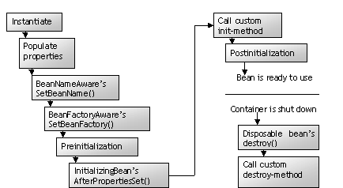
2.5 : Bean containers -Life cycle of Beans in Spring factory container
Notes:
In a traditional Java application, the life cycle of a bean is fairly simple. Java’s new keyword is used to instantiate the bean and it is ready to use. In contrast, the life cycle of a bean within a Spring container is a bit more elaborate.
A bean factory performs several setup steps before a bean is ready to use.
The container finds the bean’s definition and instantiates the bean.
Using dependency injection, Spring populates all the properties as specified in the bean definition.
If the bean implements the BeanNameAware interface, the factory calls setBeanName() passing the bean’s ID.
If the bean implements the BeanFactoryAware interface, the factory calls setBeanFactory() passing an instance of itself.
If there are any BeanPostProcessers associated with the bean, their PostProcessBeforeInitialization() methods will be called.
If an init-method is specified for the bean, it will be called.
Finally, if there are any BeanPostProcessers associated with the bean, their PostProcessAfterInitialization() methods will be called.
The bean is now ready to be used and will remain in the bean factory until it is no longer needed. It is removed from the factory in two ways:
If the bean implements the DisposableBean interface, the destroy() method is called.
If a custom destroy-method is specified, it will be called.

Slide 38
2.5 : Bean containers -Initialization and Destruction
When a bean is instantiated, some initialization can be
performed to get it to a usable state
When the bean is removed from the container, some cleanup
may be required
Spring can use two life-cycle methods of each bean to perform
this setup and teardown.
Example:
<bean id=“foo” class=“com.spring.Foo”
init-method=“setup”
destroy-method=“teardown” />
Notes:
Declaring a custom init-method in your bean’s definition specifies a method that is to be called on the bean immediately upon instantiation. Similarly, a custom destroy-method specifies a method that is called just before a bean is removed from the container.
E.g., the init-method=“setup” in the above example calls setup() method in the bean class when bean is loaded into container and teardown() when bean is removed from container.
Defaulting init-method and destroy-method:
If many of the beans in a context definition file will have initialization or destroy methods with same name, you don’ have to declare init-method or destroy-method on each individual bean. Instead, you can take advantage of the default-init-method and default-destroy-method attributes on the <beans> element.
<beans……
default-init-method=“tuneApplication”
default-destroy-method=“cleanApplication” >
……
</beans>
A typical example would be a connection pooling bean:
public class ConnPool{
public void init(){
//initialize conn pool
}
public void close(){
//release connection
}
… …
The bean definition for this snippet would appear as follows:
<bean id=“connPool” class=“com.ConnPool”
init-method=“init” destroy-method=“close” />

Slide 39
2.5 : Bean containers InitializingBean and DisposableBean
InitializingBean interface
provides afterPropertiesSet() method which is called once all
specified properties for the bean have been set.
DisposableBean interface
provides destroy() method which is called when the bean is disposed
by the container
The advantage is that Spring container is able to
automatically detect beans without any external
configuration.
The drawback is that the applications’ beans are coupled to
Spring API.
Notes:
As an option to init-method and destroy-method, we can also rewrite the bean class to implement two special Spring interfaces: InitializingBean and DisposableBean. The Spring container treats beans that implement these interfaces in a special way, by allowing them to hook into the bean lifecycle.
The InitializingBean interface provides a method afterPropertiesSet(). This is called once all specified properties for the bean have been set. This makes it possible for the bean to perform initialization that cannot be performed until all properties have been completely set.
DisposableBean provides a destroy() method which will be called on the other end of a bean-lifecycle., when the bean is disposed by the container.
The benefit of using these interfaces is that Spring container is able to automatically detect beans that implement them without any external configuration. However, the disadvantage of implementing these interfaces is that you couple your application’s beans to Spring API.
import org.springframework.beans.factory.InitializingBean;
import org.springframework.beans.factory.DisposableBean;
public class SampleBean implements InitializingBean, DisposableBean{
…
public void afterPropertiesSet(){…}
public void destroy(){…}
…}

Slide 40
2.5 Bean container - Bean containerss:Application context
Provides application framework services such as :
Resolving text messages, including support for internationalization of
these messages
Load file resources, such as images
Publish events to beans that are registered as listeners
Many implementations of application context exist:
AnnotationConfigApplicationContext
AnnotationConfigWebApplicationContext
ClassPathXmlApplicationContext
FileSystemApplicationContext
XmlWebApplicationContext
Notes:
Application contexts build on bean factory by providing application framework services. A bean factory is fine for simple applications, but to take advantage of the full power of Spring framework, we need to use the application context container, which offers services mentioned in slide above. Many implementations of application context exist:
AnnotationConfigApplicationContext : Loads a Spring application context from one or more Java-based configuration classes
AnnotationConfigWebApplicationContext : Loads a Spring web application context from one or more Java-based configuration classes
ClassPathXmlApplicationContext : Loads context definition from a XML file located in the class path.
FileSystemApplicationContext: Loads context definition from an XML file in the file system.
XmlWebApplicationContext : Loads context definition from an XML file contained within a web application
Loading the ApplicationContext: Some examples :
ApplicationContext ctx = new ClassPathXmlApplicationContext(“app.xml");
ApplicationContext ctx = new FileSystemXmlApplicationContext(“/some/file/path/app.xml");
ApplicationContext ctx = new ClassPathXmlApplicationContext( new String[]{“app1.xml“,”app2.xml”}); // combines multiple xml file fragments
Spring support Wildcards in application context constructor resource paths.
The resource paths in application context constructor values may be a simple path which has a one-to-one mapping to a target Resource, or alternately may contain the special "classpath*:" prefix and/or internal Ant-style regular expressions (matched using Spring's PathMatcher utility). Both of the latter are effectively wildcards. (Continued on next page….)
When is it appropriate to create and use a bean factory versus an application context? In all cases you are better off using an application context because you will get more features at no real cost. The main exception is something like an applet where every last byte of memory used is significant, and a bean factory will save some memory because you can use the Spring library package, which brings in only bean factory functionality, without bringing in application context functionality.
With Spring3 however, most applications use ApplicationContext, so from hereon we shall use this in all our demos

Slide 41
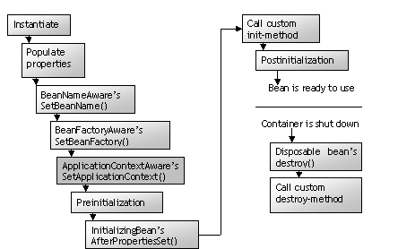
2.5 : Bean containers -ApplicationContext life cycle
Notes:
(Continued from previous page)
Eg.
/WEB-INF/*-context.xml
com/mycompany/**/applicationContext.xml
file:C:/some/path/*-context.xml
classpath:com/mycompany/**/applicationContext.xml
classpath:com/mycompany/**/service-context.xml
ApplicationContext ctx = new ClassPathXmlApplicationContext("classpath*:conf/appContext*.xml");
ApplicationContext life cycle:
The life cycle of a bean within a Spring ApplicationContext differs only slightly from that of a bean within a bean factory as shown in above figure.
The only difference is that if a bean implements the ApplicationContextAware interface, the setApplicationContext() method is invoked.

Slide 42
2.5 : Bean containers -Prototyping Vs Singleton
By default, all Spring beans are singletons.
But each time a bean is asked for, prototyping lets the container return a new instance.
This is achieved through the scope attribute of <bean>
Example:
Additional Bean scopes:
request
session
global-session
<bean id=“foo” class=“com.igate.Foo” scope=“prototype” />
Notes:
Singleton beans, the default, are created only once by the container and all calls to BeanFactory.getBean() return the same instance. The container will then hold and use the same instance of the bean whenever it is referenced again. This can be significantly less expensive in terms of resource usage than creating a new instance of the bean on each request.
A non-singleton, or prototype bean, may be specified by setting the scope attribute to prototype (see example above). The lifecycle of a prototype bean will often be different than a singleton. When a container is asked to supply a prototype bean, it’s initialized and then used, but the container does not hold on to it past that point.
Prototyped beans are useful when you want the container to give a unique instance of a bean each time it is asked for, but you still want to configure one or more properties of the bean through Spring. Thus a new instance is created when getBean() is invoked with the bean’s name.
Previous versions of Spring had IoC container level support for exactly two distinct bean scopes (singleton and prototype). Spring 2.0 onwards provides a number of additional scopes depending on the environment in which Spring is being deployed (for example, request and session scoped beans in a web environment).
It also provides integration points so that Spring users can create their own scopes. Beans can be defined to be deployed in one of a number of scopes. See the table in the next page for the different scopes.

Slide 43
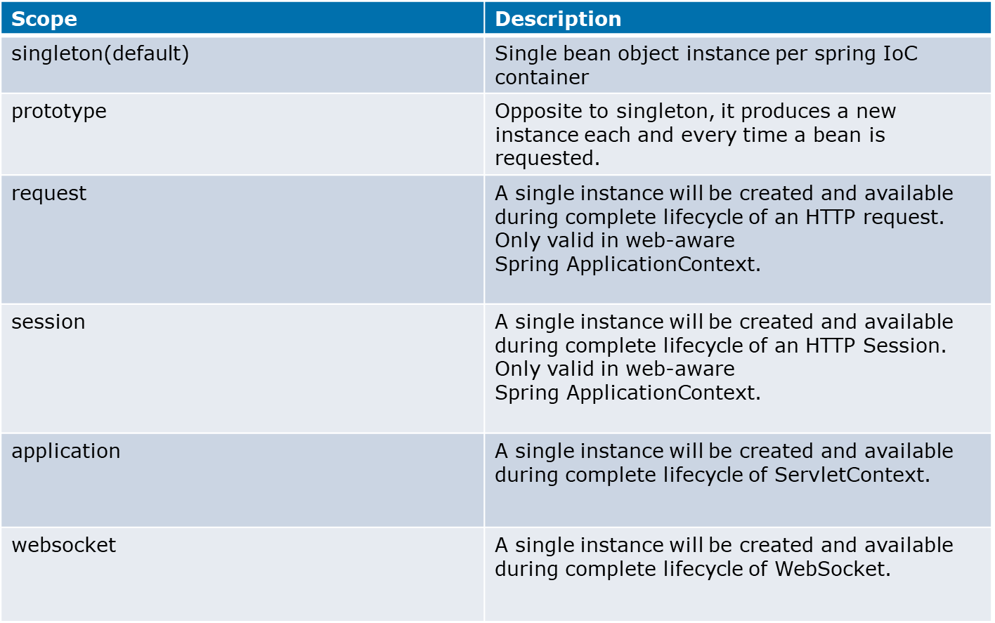
2.5 : Bean containers -Bean scopes
Notes:
An example:
<bean id="accountService" class="com.foo.DefaultAccountService" scope="singleton"/>
The request, session, and global session scopes are only available if you use a web-aware
Spring ApplicationContext implementation (such as XmlWebApplicationContext). If you
use these scopes with regular Spring IoC containers such as the
ClassPathXmlApplicationContext, you get an IllegalStateException complaining
about an unknown bean scope.

Slide 44
2.5 Bean Configuration With Collection Objects
package com.cg.collection;
public class JavaCollection {
List addressList;
Set addressSet;
Map addressMap;
Properties addressProp;
//getters and setters
}

Slide 45
2.5 Bean Configuration With Collection Objects(.xml )
<beans>
<bean id = "javaCollection" class = "com.cg.collection.JavaCollection">
<!-- results in a setAddressList(java.util.List) call -->
<property name = "addressList">
<list>
<value>INDIA</value>
<value>Pakistan</value>
<value>USA</value>
<value>USA</value>
</list>
</property>
<!-- results in a setAddressSet(java.util.Set) call -->
<property name = "addressSet">
<set>
<value>INDIA</value>

Slide 46
2.5 Bean Configuration With Collection Objects(.xml )
<value>Pakistan</value>
<value>USA</value>
<value>USA</value>
</set>
</property>
<!-- results in a setAddressMap(java.util.Map) call -->
<property name = "addressMap">
<map>
<entry key = "1" value = "INDIA"/>
<entry key = "2" value = "Pakistan"/>
<entry key = "3" value = "USA"/>
<entry key = "4" value = "USA"/>
</map>
</property>

Slide 47
2.5 Bean Configuration With Collection Objects(.xml )
<!-- results in a setAddressProp(java.util.Properties) call -->
<property name = "addressProp">
<props>
<prop key = "one">INDIA</prop>
<prop key = "one">INDIA</prop>
<prop key = "two">Pakistan</prop>
<prop key = "three">USA</prop>
<prop key = "four">USA</prop>
</props>
</property>
</bean>
</beans>

Slide 48
2.5 : Bean containers -Customizing beans with BeanPostProcessor
Post processing involves cutting into a bean’s life cycle and
reviewing or altering its configuration.
Occurs after some event has occurred.
Spring provides two interfaces :
BeanPostProcessor interface
BeanFactoryPostProcessor interface
ApplicationContext automatically detects Bean Post-Processor,
but these have to manually be explicitly registered for bean
factory.
Notes:
The lifecycle of the BeanFactory and ApplicationContext provide many opportunities to cut into the bean’s life cycle to review or alter its configuration. This is called post processing and occurs after some event has occurred. A bean post-processor is a java class which implements the BeanPostProcessor interface, which consists of two callback methods:
postProcessBeforeInitialization: called immediately before bean initialization.
postProcessAfterInitialization: called immediately after bean Initialization.
BeanPostProcessors operate on bean (or object) instances; ie the Spring IoC container instantiates a bean instance and then BeanPostProcessor interfaces do their work.
An ApplicationContext will automatically detect any beans which are deployed into it which implement the BeanPostProcessor interface, and register them as post-processors, to be then called appropriately by the factory on bean creation. Simply deploy the post-processor in a similar fashion to any other bean! However, for BeanFactory, bean post-processors have to manually be explicitly registered, with a code sequence as shown below.
Since this manual registration step is not convenient, and ApplictionContexts are functionally supersets of BeanFactories, it is generally recommended that ApplicationContext variants are used when bean post-processors are needed.
ConfigurableBeanFactory bf = new .....; // create BeanFactory
// now register some beans and any needed BeanPostProcessors
MyBeanPostProcessor pp = new MyBeanPostProcessor();
bf.addBeanPostProcessor(pp); // now start using the factory ...
If you want to implement some custom logic after the Spring container finishes instantiating, configuring, and otherwise initializing a bean, you can plug in one or more BeanPostProcessor implementations.
We shall not focus on this interface further

Slide 49
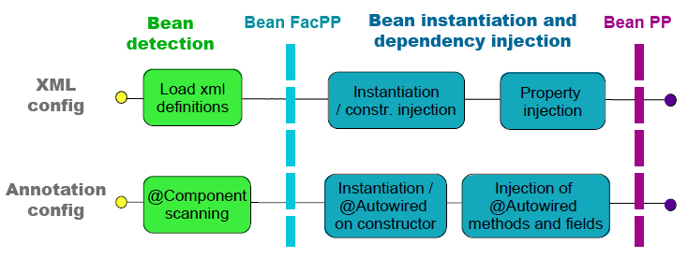
2.5 : Bean containers -Lifecycle execution with PostProcessors
Notes:
Discuss about annotation config later.
ConfigurableBeanFactory bf = new .....; // create BeanFactory
// now register some beans and any needed BeanPostProcessors
MyBeanPostProcessor pp = new MyBeanPostProcessor();
bf.addBeanPostProcessor(pp); // now start using the factory ...
If you want to implement some custom logic after the Spring container finishes instantiating, configuring, and otherwise initializing a bean, you can plug in one or more BeanPostProcessor implementations.
We shall not focus on this interface further

Slide 50
2.6 : Customizing beans -Customizing beans with BeanFactoryPostProcessor
BeanFactoryPostProcessor performs post processing on the entire
Spring container.
It has a single method, which is postProcessBeanFactory().
Spring offers a number of pre-existing bean factory post-processors:
AspectJWeaving
CustomAutowireConfigurer
CustomEditorConfigurer
CustomScopeConfigurer
PropertyPlaceholderConfigurer
PreferencesPlaceholderConfigurer
PropertyOverrideConfigurer
Notes:
BeanFactoryPostProcessors operate on the bean configuration metadata; that is, the Spring IoC container allows BeanFactoryPostProcessors to read the configuration metadata and potentially change it before the container instantiates any beans other than BeanFactoryPostProcessors.!
Has a single method – postProcessBeanFactory(). This is called by Spring container after all bean definitions have been loaded but before any beans are instantiated (including BeanPostProcessor beans).
Spring offers a number of pre-existing bean factory post-processors. Two very useful implementations are:
PropertyPlaceholderConfigurer : Loads properties from one or more external property files and uses these properties to fill in place holder variables in the bean wiring XML file.
CustomEditorConfigurer : Lets you register custom implementation of java.beans.PropertyEditor to translate property wired values to other property types.
Let’s take a look at how you can use these implementations of BeanFactoryPostProcessor.

Slide 51
2.6 : Customizing beans -PropertyPlaceholderConfigurer
It is possible to configure entire application in a single bean
wiring file.
But, sometimes it is beneficial to extract certain pieces of that
configuration into a separate property file.
<bean id=“datasource” class=“com.spring.ConnectionDataSource” >
<property name=“url”>
<value> jdbc:hsqldb:training </value>
</property>
<property name=“driverclassname”>
<value> org.hsqldb.jdbcDriver </value>
</property>
….
</bean>
Notes:
For the most part, it is possible to configure entire application in a single bean wiring file. But sometimes it is beneficial to extract certain pieces of that configuration into a separate property file. E.g. , a configuration concern common to many applications is configuring a data source. Traditionally, in Spring, you do this with the following XML in the bean wiring file (see above)
Configuring the data source directly in the bean wiring file may not be appropriate. The database specifics are a deployment detail and must be separated.

Slide 52
2.6 : Customizing beans -PropertyPlaceholderConfigurer
Externalizing properties using PropertyPlaceholderConfigurer
indicates Spring to load certain configuration from an external
property file.
<bean id="placeHolderConfig" class=“org.springframework.beans.
factory. config.PropertyPlaceholderConfigurer">
<property name="location“ value=“data.properties” />
</bean>
<bean id="dataSource" class="org.apache.commons.dbcp.BasicDataSource">
<property name="driverClassName" value="${jdbc.driverClassName}"/>
<property name="url" value="${jdbc.url}"/>
<property name="username" value="${jdbc.username}"/>
<property name="password" value="${jdbc.password}"/>
</bean>
jdbc.driverClassName=oracle.jdbc.driver.OracleDriver
jdbc.url=jdbc:oracle:thin:@192.168.224.26:1521:trgdb
…..
Notes:
Fortunately, externalizing properties in Spring is easy if you are using ApplicationContext as your Spring container. You can use PropertyPlaceholderConfigurer to tell Spring to load certain configuration from an external property file as shown in the code snippet above. The location property tells Spring where to find the property file data.properties.
When Spring creates the bean, the PropertyPlaceholderConfigurer will step in and replace the place holder variables with the values from the property file. It pulls values from a properties file into bean definitions.

Slide 53
2.6 : Customizing beans -Demo: DemoSpring_6
This demo shows how to use the
PropertyPlaceholderConfigurer
BeanFactoryPostProcessor
Notes:
Please refer to demo, DemoSpring_6. In this case user.java is a POJO with two properties – username and password. We shall set the properties of this bean during its instantiation using external properties file. user.properties is a properties file. user.xml has two place holder variables ${username} and ${password}
Whenever setter is called, the listener (PropertyPlaceholderConfigurer) is invoked and it will look into the properties file, retrieve values, place them in the place holders and initialize.
If instead of application context, bean factory is used, then the listener would have to be explicitly registered as shown below (also in the commented out code in userClient.java file).
XmlBeanFactory factory = new XmlBeanFactory(new FileSystemResource("user.xml"));
PropertyPlaceholderConfigurer cfg = new PropertyPlaceholderConfigurer();
cfg.setLocation(new FileSystemResource("user.properties"));
cfg.postProcessBeanFactory(factory);
<bean id="user" class="training.spring.User">
<property name="username"><value>${username}</value></property>
<property name="password"><value>${password}</value></property>
</bean>

Slide 54
2.6 : Customizing beans - CustomEditorConfigurer
CustomEditorConfigurer is a bean factory post-processer which
allows to convert values in String form to final property values.
It allows you to register custom implementation of
PropertyEditor to translate property wired values to other
property types.
Java.beans.PropertyEditorSupport is a convenience
implementation java.beans.PropertyEditor interface that allows
setting a non-string property to a string value.
It has two methods: getAsText() and setAsText(String s)
Notes:
CustomEditorConfigurer : Lets you register custom implementation of java.beans.PropertyEditor to translate property wired values to other property types. This is a bean factory post-processer which allows to convert values in String form to final property values.
So far, we have seen several examples in which a complex property is set with a simple String value. When setting bean properties as a string value, a BeanFactory ultimately uses standard java.beans. PropertyEditor interface to convert these strings to the complex type of the property. There is a convenience implementation of the above interface called java.beans.PropertyEditorSupport,that has two methods of interest to us:
getAsText() : returns the String representation of a property’s value.
setAsText(String value) : sets a bean property value from the string value passed in.
If an attempt is made to set a non-string property to a string value, the setAsText() method is called to perform the conversion. Likewise, the getAsText() is called to return a textual representation of the property’s value.
Spring comes with several custom editors based on PropertyEditorSupport. You can also write your own custom editor by extending the PropertyEditorSupport class.

Slide 55
2.6 : Customizing beans -CustomEditorConfigurer
<bean id="customEditorConfigurer" class="org.springframework.
beans.factory.config.CustomEditorConfigurer">
<property name="customEditors">
<map>
<entry key="java.util.Date“ value="MyCustomDateEditor"/>
</map>
</property>
</bean>
CustomEditorConfigurer configurer = (CustomEditorConfigurer)
factory.getBean(“customEditorConfigurer “);
Configurer.postProcessBeanFactory(factory);
BeanClass bean = (BeanClass) factory.getBean(“exampleBean”);
Notes:
Declarative registration process:
The custom PropertyEditors (MyCustomDateEditor in this case) is injected into the CustomEditorConfigurer class using the Map-typed customEditors property. A map can have multiple entries and each entry in the Map represents a single PropertyEditor with the key of the entry being the name of the class for which the PropertyEditors is used.
In the above first example, the key for the MyCustomDateEditor is java.util.Date, which signifies that this is the class for which the editor should be used.
Programmatic Registration Process:
The second code snippet shows a call to Configurer.postProcessBeanFactory(), which passes in the BeanFactory instance. This is another method of registering custom editors in Spring. You should call this before you attempt to access any beans that need to use the custom PropertyEditors.
However, adding a new PropertyEditor means changing the application code, whereas with the declarative mechanism, you can define your editors as beans, which means you can configure them using DI. Besides, using Application Context means no java code to use the declarative mechanism, which strengthens the argument against programmatic mechanism.

Slide 56
2.6 : Customizing beans -Demo: DemoSpring_7
This demo shows how to use the
CustomEditorConfigurer
BeanFactoryPostProcessor
Notes:
Please refer to DemoSpring_7. The Employee.java is a POJO that holds the date property. Using basic wiring techniques learnt so far, you could set a value into Employee beans’ date property. But we have created SQLDateEditor.java extending PropertyEditorSupport class.
Spring must recognize this custom property editor when wiring bean properties using Spring’s CustomEditorConfigurer. This BeanFactory PostProcesser internally loads custom editors into the BeanFactory by calling the registerCustomEditor() method. By adding the following bit of XML into the bean configuration file, you will tell Spring to register the SQLDateEditor as a custom editor.
You will now be able to configure the Employee objects date property using a simple string value:
<bean id="employee“ class="training.spring.Employee">
<property name="date"><value>2006-01-01</value></property>
</bean>
<bean id="customEditorConfigurer“ class="org. springframework. beans.
factory.config.CustomEditorConfigurer">
<property name="customEditors">
<map> <entry key="java.sql.Date">
<bean class="training.spring.SQLDateEditor" /></entry>
</map>
</property>
</bean>

Slide 57
2.6 : Customizing beans Internationalization: Resolving text messages
ApplicationContext interface provides messaging functionality by
extending MessageSource interface.
getMessage() is a basic method used to retrieve a message from
the MessageSource.
On loading, ApplicationContext automatically searches for a
MessageSource bean defined in the context.
ResourceBundleMessageSource is a ready-to-use implementation
of MessageSource.
Notes:
Many times you may not want to hard-code certain text that will be displayed to the user. This may be because text is subject to change or perhaps your application will be internationalized and you will display text in the user’s native language.
Java’s support for parameterization and internationalization of messages enables you to define one or more properties files that contain the text that is to be displayed in your application. There should always be a default message file along with optional language-specific message files. For ex: if name of the application’s message bundle is “MsgText”, you may have the following set of message property files:
MsgText.properties: Default messages when a locale cannot be determined or locale-specific properties file is not available.
MsgText_en_US.properties: text for English speaking users in US.
Spring’s ApplicationContext supports parameterized messages by making them available to the container through the MessageSource interface that has a single method – getMessage(). Spring comes with a ready-to-use implementation of MessageSource – the ResourceBundleMessageSource. This simply uses Java’s own java.util. ResourceBundle to resolve messages. A ResourceBundleMessageSource works on a set of properties files that are identified by base names. When looking for a message for a particular Locale, the ResourceBundle looks for a file that is named as a combination of base name and the Locale name. For e.g. : applicationResources_fr will match a French locale.

Slide 58
2.6 : Customizing beans -Internationalization: Resolving text messages
<bean id="messageSource“ class="org.springframework.context.
support.ResourceBundleMessageSource">
<property name="basename">
<value>applicationResources</value></property>
</bean>
MessageSource messageSource = (MessageSource) factory.getBean
("messageSource");
Locale locale = new Locale("en","US");
String msg = messageSource.getMessage("welcome.message", null,
locale);
Notes:
To use ResourceBundleMessageSource, add the above xml entry (the first code snippet) to the bean wiring file.
It is very important that this bean be named messageSource because the ApplicationContext will look for a bean specifically by that name when setting up its internal message source.
The basename property specifies the base name of the bundle. The bundle will normally look for messages in properties files with names that are variations of base name depending on locale.
You will never need to inject the messageSource bean into your application beans but will instead access messages via ApplicationContext’s own getMessage() methods. For e.g. to retrieve the message whose name is ”welcome.message”, please refer to the second code snippet above.
You will likely be using parameterized messages in the context of a web application, displaying the text on a web page. In that case, you can use Spring’s <spring:message> jsp tag to retrieve messages and need not need directly access the ApplicationContext.
< spring:message code=“welcome.message” />
Alternatively, you can use the second argument of the getMessage() to pass in an array of arguments that will be filled in for params within the message

Slide 59
2.6 : Customizing beans -DemoSpringI18N
This demo shows how to provide messaging
functionality in the application context.
Notes:
Please refer to DemoSpringI18N. There are two resource bundles defined :
applicationResources_en_GB.properties
applicationResources_en_US.properties
Message source has been defined in message.xml
MessageClient.java creates a new locale object and uses the getMessage() to access messages from the appropriate resource bundle based on locale. Notice that the message is parameterized :
welcome.message = Welcome {0}, in UK
Hence we need to send value for {0} parameter in this manner:
String msg = messageSource.getMessage("welcome.message", new Object[]{"Majrul"},locale);
This will set the value of the {0} parameter to “Majrul”. We can pass in many parameters for a single message, by using this object array in the getMessage() method.
Additional notes for instructor

Slide 60
2.7: Spring Annotations -Annotation-based configuration
Spring has a number of custom annotations:
@Required
@Autowired
@Resource
@PostConstruct
@PreDestroy
Annotations to configure beans:
@Component
@Controller
@Repository
@Service
Notes:
So far, we have configured our beans in the XML configuration files. Starting with Spring 2.0, we can use annotations to configure our beans. By annotating your classes, you state their typical usage or stereotype. Spring has a number of custom (Java5+) annotations.
@Required : The @Required annotation is used to specify that the value of a bean property is required to be dependency injected. That means, an error is caused if a value is not specified for that property
@Autowired: Prior to Spring 2.5, autowiring could be configured for a number of different approaches: constructor, setters by type, setters by name, or autodetect – which offer a large degree of flexibility, but not very fine-grained control. For eg, it has not been possible to autowire a specific subset of an object's setter methods or to autowire some of its properties by type and others by name. By using @Autowired, you can eliminate the additional XML in your configuration file that specifies the relationship between two objects. Also, you no longer need methods to set the property in the owning class. Just include a private or protected variable and Spring will do the rest.
@Resource : Declares a reference to a resource such as a data source, Java Messaging Service (JMS) destination, or environment entry. This annotation is equivalent to declaring a resource-ref, message-destination-ref, env-ref, or resource-env-ref element in the deployment descriptor.
Annotation injection is performed before XML injection, thus the latter configuration will
override the former for properties wired through both approaches.

Slide 61
2.7: Spring Annotations -Annotation-based configuration
Annotations to configure Application:
@Configuration
@Import
@Bean
@EnableAutoConfiguration
@ComponentScan
Some other transactions:
@Transactional
@AspectJ
Notes:
So far, we have configured our beans in the XML configuration files. Starting with Spring 2.0, we can use annotations to configure our beans. By annotating your classes, you state their typical usage or stereotype. Spring has a number of custom (Java5+) annotations.
@Required : The @Required annotation is used to specify that the value of a bean property is required to be dependency injected. That means, an error is caused if a value is not specified for that property
@Autowired: Prior to Spring 2.5, autowiring could be configured for a number of different approaches: constructor, setters by type, setters by name, or autodetect – which offer a large degree of flexibility, but not very fine-grained control. For eg, it has not been possible to autowire a specific subset of an object's setter methods or to autowire some of its properties by type and others by name. By using @Autowired, you can eliminate the additional XML in your configuration file that specifies the relationship between two objects. Also, you no longer need methods to set the property in the owning class. Just include a private or protected variable and Spring will do the rest.
@Resource : Declares a reference to a resource such as a data source, Java Messaging Service (JMS) destination, or environment entry. This annotation is equivalent to declaring a resource-ref, message-destination-ref, env-ref, or resource-env-ref element in the deployment descriptor.
@PostConstruct : Specifies a method that the container will invoke after resource injection is complete but before any of the component's life-cycle methods are called.
@PreDestroy : Specifies a method that the container will invoke before removing the component from service.
When Spring discovers one of these annotations, it creates the appropriate bean by matching the stereotype.
Annotations to configure beans:
@Component: Is the basic stereotype. Classes annotated with this will become spring beans.
@Controller: Classes annotated with this annotation will be considered as a Controller in Spring MVC support.
@Repository: Classes with @Repository annotation represent a repository (eg a data access object)
@Service: This annotation marks classes that implement a part of the business logic of the application.
Annotations to configure application
@Configuration indicates that the class can be used by the Spring IoC container as a source of bean definitions.
@Import : Using this annotation you can import one or more @Configuration classes. It can also import classes containing at least one @Bean method.
@Bean annotation tells Spring that a method annotated with @Bean will return an object that should be registered as a bean in the Spring application context.
@EnableAutoConfiguration annotation will trigger automatic loading of all the beans the application requires
@ComponentScan : An equivalent for Spring XML's <context:component-scan/> is provided with the @ComponentScan annotation.
Some other annotations:
@Transactional: is an alternative to the XML-based declarative approach to transaction configuration. All methods of a Spring bean instantiated from a class with the @Transactional annotation will be transactional (thus indirectly, all methods will execute in a transaction). The functionality offered by the @Transactional annotation and the support classes is only available to you if you are using at least Java 5
@Aspect : This annotation on a class marks it as an aspect along with @Pointcut definitions and advice (@Before, @After, @Around)
We shall be covering each of these as we move forwards into AOP, database programming and web applications.
Annotation injection is performed before XML injection, thus the latter configuration will
override the former for properties wired aough both approaches.

Slide 62
2.7: Spring Annotations -@Autowired annotation
<?xml version="1.0" encoding="UTF-8"?>
<beans xmlns="http://www.springframework.org/schema/beans"
xmlns:xsi="http://www.w3.org/2001/XMLSchema-instance"
xmlns:context="http://www.springframework.org/schema/context"
xsi:schemaLocation="http://www.springframework.org/schema/beans
http://www.springframework.org/schema/beans/spring-beans.xsd
http://www.springframework.org/schema/context
http://www.springframework.org/schema/context/spring-context-4.0.xsd"> <context:annotation-config />
<context:component-scan base-package=“training.spring“ />
<!-- bean declarations go here -->
</beans>
Notes:
We can use annotations to automatically wire bean properties. It is similar to autowire attribute in configuration file, but allows more fine-grained autowiring, where you can selectively annotate certain properties for autowiring.
However, simply annotating your classes is not enough to get an annotation’s behavior. You need to enable a component that is aware of the annotation and that can process it appropriately. This component (a special BeanPostProcessor implementation) will be different for all annotations. For eg, the RequiredAnnotationBeanPostProcessor class is necessary for @Required annotation.
Annotation wiring isn’t turned on in the Spring container by default. So, before we can use annotation-based autowiring, we’ll need to enable it in our Spring configuration. The simplest way to do that is with the <context:annotation-config> element from Spring’s context configuration namespace.
<context:annotation-config> tells Spring that you intend to use annotation-based wiring in Spring. Once it’s in place you can start annotating your code to indicate that Spring should automatically wire values into properties, methods, and constructors. The implicitly registered post-processors include AutowiredAnnotationBeanPostProcessor, CommonAnnotationBeanPostProcessor, PersistenceAnnotationBeanPostProcessor, as well as the RequiredAnnotationBeanPostProcessor.

Slide 63
2.7: Spring Annotations -Execution with Spring Boot
@Component("hello")
public class HelloWorld {
public String sayHello() {
return "Hello";
}
}
@Configuration
@EnableAutoConfiguration
@ComponentScan("com.igate")
public class Client {
public static void main(String[] args) {
ApplicationContext context = SpringApplication.run(Client.class, args);
HelloWorld bean = (HelloWorld) context.getBean(HelloWorld.class);
String s=bean.sayHello();
System.out.println(s);
}
}
Notes:
We can use annotations to automatically wire bean properties. It is similar to autowire attribute in configuration file, but allows more fine-grained autowiring, where you can selectively annotate certain properties for autowiring.
However, simply annotating your classes is not enough to get an annotation’s behavior. You need to enable a component that is aware of the annotation and that can process it appropriately. This component (a special BeanPostProcessor implementation) will be different for all annotations. For eg, the RequiredAnnotationBeanPostProcessor class is necessary for @Required annotation.
Annotation wiring isn’t turned on in the Spring container by default. So, before we can use annotation-based autowiring, we’ll need to enable it in our Spring configuration. The simplest way to do that is with the <context:annotation-config> element from Spring’s context configuration namespace.
<context:annotation-config> tells Spring that you intend to use annotation-based wiring in Spring. Once it’s in place you can start annotating your code to indicate that Spring should automatically wire values into properties, methods, and constructors. The implicitly registered post-processors include AutowiredAnnotationBeanPostProcessor, CommonAnnotationBeanPostProcessor, PersistenceAnnotationBeanPostProcessor, as well as the RequiredAnnotationBeanPostProcessor.

Slide 64
2.7: Spring Annotations -DemoSpring_Anno
This demo illustrates autowired annotation
Notes:
Please refer to demo, DemoSpring_Anno, This example uses the anno.xml for configuring the beans.
Notice how the CurrencyConverterImpl.java depends on the com.igate.anno.ExchangeServiceImpl.java class for services. Notice how the exchangeService property has been annotated with @Autowired. The configuration file now just contains beans declaration and no instructions on wiring!

Slide 65
2.7: Spring Annotations -Annotating beans for autodiscovery
Refer to demos, DemoSpring_Anno
Notes:
Refer to demo, DemoSpring_Anno , Notice the anno.xml configuration file. It contains no beans! Notice the bean classes themselves are annotated with @Component, @PostConstruct, @Autowired etc.

Slide 66
Lab
From the lab guide
Lab-1 problem-statement-1 2 and 3

Slide 67
Lesson Summary
We have so far seen:
What is Spring and why spring?
The Spring architecture
Inversion of control
Bean containers
Lifecycle of beans in containers.
Some popular implementations of
BeanFactoryPostProcessors
Notes:
Thus we have seen that Spring is the most popular and comprehensive of the lightweight J2EE frameworks that have gained popularity since 2003.
We saw how Spring is designed to promote architectural good practice. A typical spring architecture will be based on programming to interfaces rather than classes.
We have seen what is Inversion of control and dependency injection.
We also saw Bean containers and lifecycle of beans in containers. We saw how to hook into the lifecycle of a bean and make it aware of the Spring environment.

Slide 68
Review Questions
Question 1: The <constructor-arg> element has
an optional ______attribute that specifies the
ordering of the constructor arguments.
Option 1: By index
Option 2: By type
Option 3: By order
Question 2: A ___________ bean lets the
container return a new instance each time a bean
is asked for in a non-web application
Option 1: Singleton
Option 2: Prototype
Option 3: Request
Option 4: session
Notes:
Ans-1 : a
Ans-2 : b

Slide 69
Review Questions
Question 3: Specifying the _____ tag will allow
Spring to validate at deployment time that the
other bean actually exists.
Option 1: idref
Option 2: ref
Option 3: local
Question 4: The BeanPostProcessor performs post
processing on the entire Spring container.
Option 1: True
Option 2: false
Notes:
Ans-3 : idref
Ans-4 : False, it is the BeanFactoryPostProcessor that does this.

Slide 70
Review Questions
Question 5: The _________ effectively creates a
bean of type java.util.Map that contains all of the
values or beans that it contains .
Option 1: <util:list>
Option 2: <util:properties>
Option 3: <util:map>
Question 6: If @Value annotation is used in a
component, it is mandatory that the component be
annotated with @Component
Option 1: True
Option 2: False
Notes:
Ans-5-Option 3
Ans-6-Option 1

